Slide 1
Fashion Illustration
Compositional Techniques
Gouache Blue Dress
Mixed media Fashion Illustration project

Slide 2
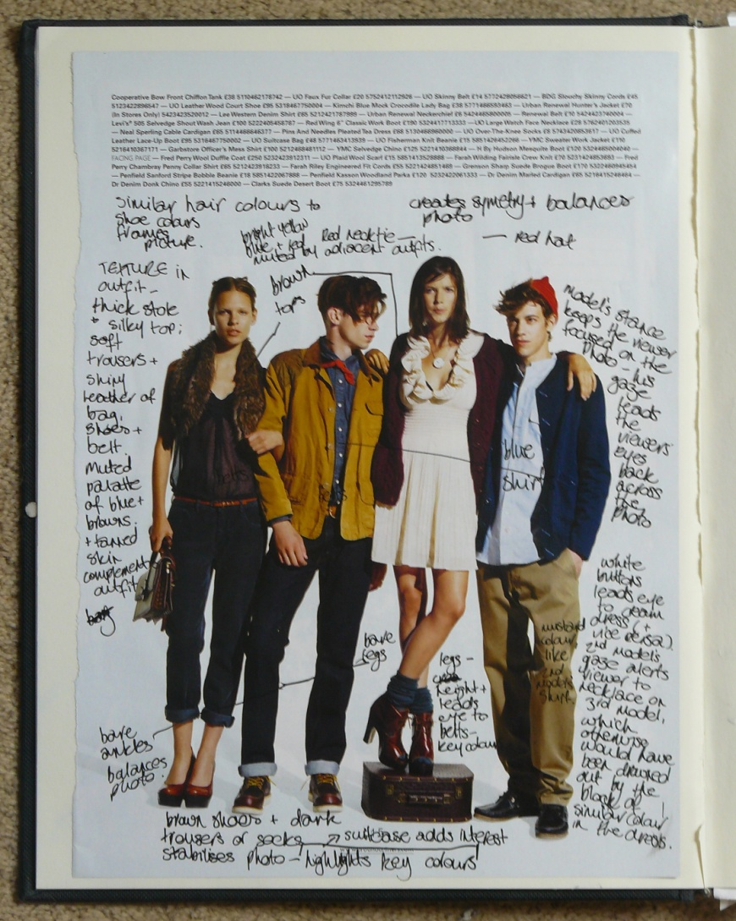
Compositional
Techniques
I included this evaluation from one of my sketchbooks because I consider the photograph to have been very cleverly put together. Although four models of mixed sex are featured, the resulting photograph is perfectly balanced. It advertises a casual look. perfectly. I like how so many elements are included yet it is easy to pick out the key colours of the season: earthy tones of deep brown, tan, navy blue and burgundy form the basis of the palette and are brightened with red, mustard yellow, pale blue and khaki. Opposite I detail how these colours are used well in the composition. The textures are equally well considered: thick wool, corduroy and soft cotton are contrasted with bare legs, patent leather and silk. Details draw the eyes across photo: the use of medium toned blue in the turn-ups, shirt, socks and cardigan; light blue turn-ups and shirt; the cream dress, necklace and cream buttons on the mid-blue shirt and red details on the male models all make the photo aesthetically satisfying. the combination of the models’ mid-brown hair and the brown patent leather balance the other tones in the photograph. The relaxed stances draw attention towards the clothes and amplify the casual look.
Taken from the January edition of the Urban Outfitters promotional magazine.

Slide 3
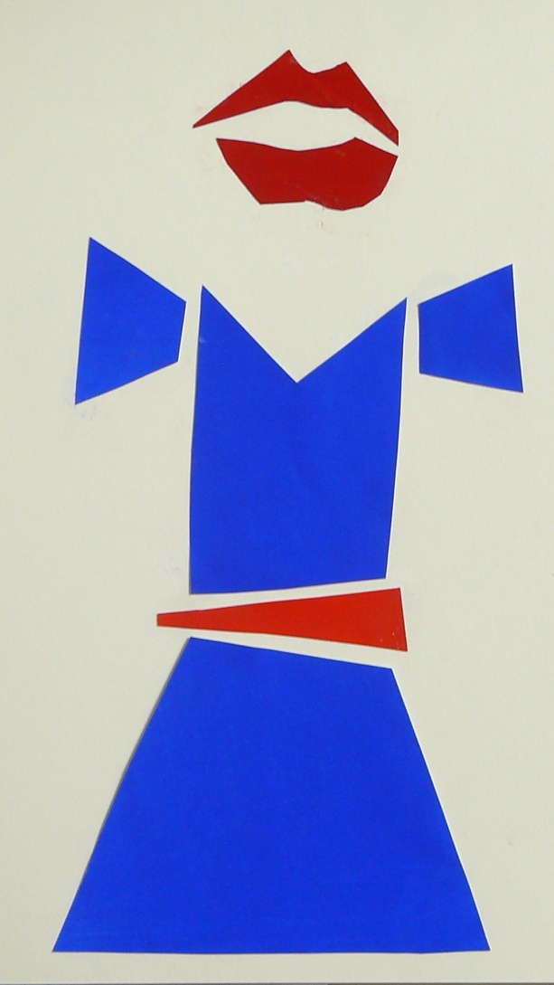
Blue Dress
Gouache on 100gsm paper
I used gouache because of its vibrancy.
I have created a minimalist piece with oversized, separated pieces and a large pair of lips to create a strong image.
This piece was influenced by the abstract aesthetic of the ‘De Stijl’ group. The block colour and the spacing between the coloured paper reflects this.
I deliberately made the pieces of the clothing mismatched and awkward and the mouth somewhere between a pout, a sneer and surprise to give the piece a slightly unsettling edge.
I used ready mixed colour (ultramarine on the dress, cadmium red on the belt and mars red on the lips) to ensure uniform colour throughout.

Slide 4
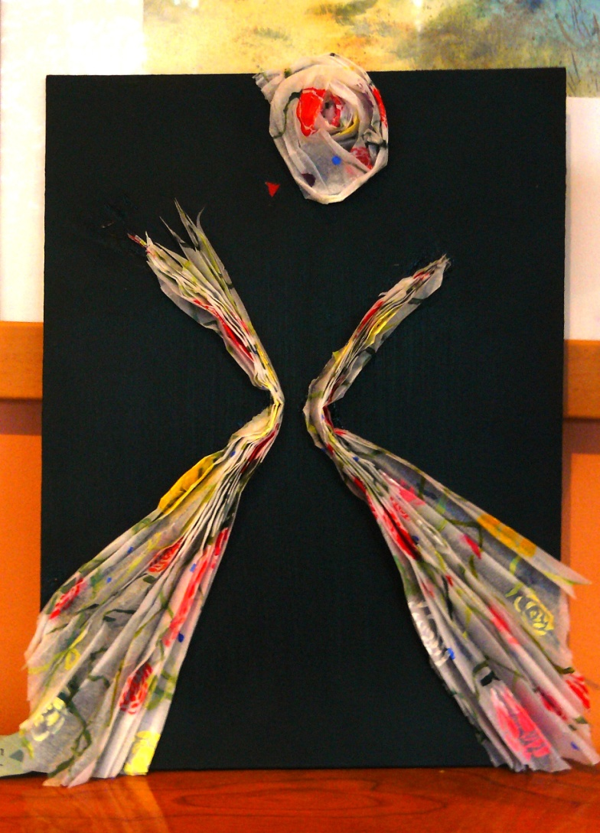
Fashion Illustration Project
Final piece

Slide 5
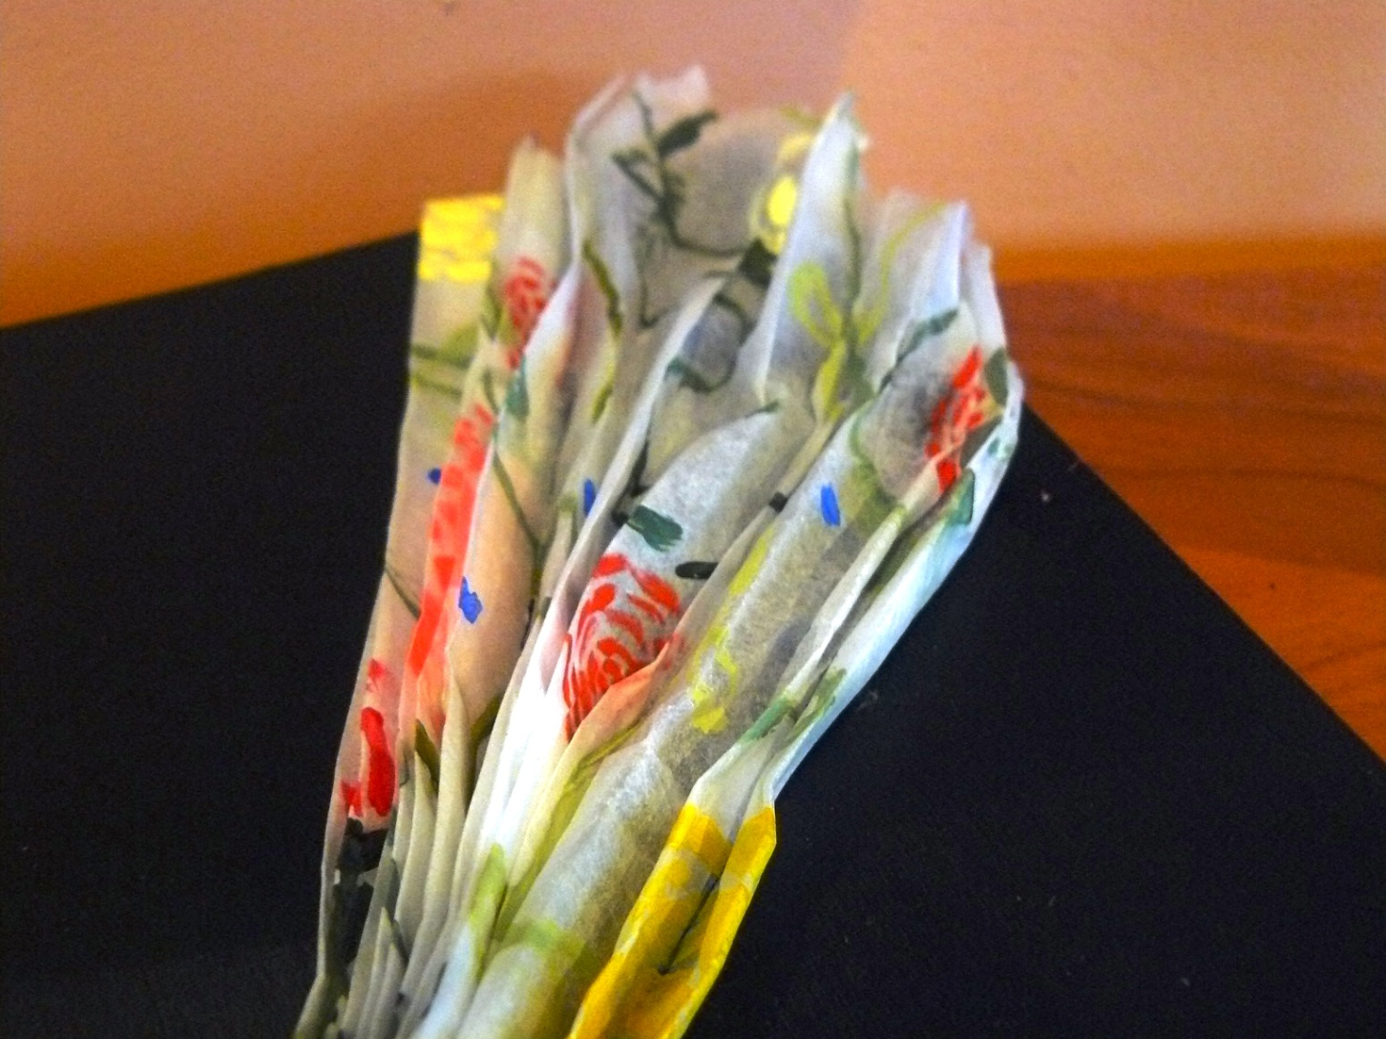
Final piece,
detail

Slide 6
Development
I intended this illustration to have a strong sense 1940’s and 50’s style. I took inspiration from the work of fashion illustrator Rene Gruau, whose work I saw at the ‘Dior Illustrated: Rene Gruau and the Line of Beauty’ exhibition at Somerset House. I also took inspiration from illustrations from ‘Costume, 1066 – 1990s: A Complete Guide to English Costume Design and History by J. Peacock (Thames & Hudson, 1994, 2nd edition). I wanted to evoke the beauty and glamour of Gruau’s images. Below I detail the development of this piece.
Background
I painted an watercolour board with acrylic in mars black, layering the paint to create an intense lacquered black. I used black because to create drama by juxtaposing the dark background with the lightness of the tissue paper.
By using vertical brushstrokes I hoped to imbue the finished piece more of a statuesque feel.
N.B.: All images with the title ‘Illustration’ are works by Gruau.

Slide 7
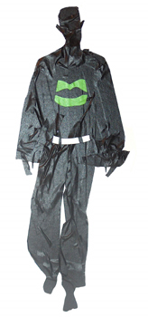
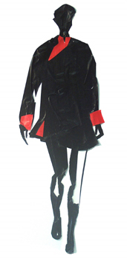
Materials
Although I wanted to create this piece to reflect the influence of Gruau’s work on mine I intended it to have contemporary nuances.
I like how contemporary illustrator Carlos Aponte creates complex multidimensional fashion illustrations using masking tape and duct tape. I wanted to utilise the technique of turning an ordinary two dimensional material into a three dimensional artwork.
I chose to use tissue paper because it is translucent and
lightweight. I wanted it to be evocative of chiffon. I
folded the painted tissue paper into a concertina to
make it three dimensional. This also allowed me to
control the width of the paper.
I used acrylic paint because it adheres well to paper,
has a vibrant colour and dries quickly.
I applied the pattern with a fairly stiff 0 size brush
to achieve crisp, italic brushstrokes.
Carlos Aponte
(no title) duct tape
Images: http://www.art-dept.com/illustration/aponte/index.html

Slide 8
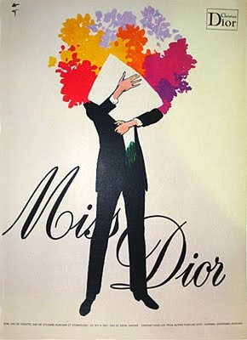
Pattern
The pattern was heavily influenced by Gruau’s illustrations: the riotous colour and floral theme of illustrations 1 and 2 inspired me to create a floral pattern. I used roses because they are the classic flower of romance.
I used roses in shades of red, yellow, pink and cream. I used neat crimson, cadmium red and cadmium yelIow; I mixed the pink from titanium white and crimson and the cream from titanium white and cadmium yellow. I kept the colours bold to adhere to Gruau’s bold use of colour. I used specks of cobalt blue to balance the warm colours of the roses and to give the pattern greater complexity.
I gave the pattern a romantic feel by extending and curling the lines of the stems across the paper.
I decided to give the roses a contemporary feel
so I painted them in a stylised way to give a stencilled effect . I have since noticed that they evoke Charles Rennie Mackintosh’s roses – this was entirely unintentional, but it interested me – I was aware of Mackintosh’s work from a young age and wonder whether it has left a greater impression on me than I had thought. ‘The ribs of the ships he had seen as a child are echoed in the structure of his sculptures’, (a quotation from an interviewer of the sculptor Rick Kirby who I profile later) suggests that childhood experiences of art can indeed manifest in adulthood.
Illustration 1

Slide 9
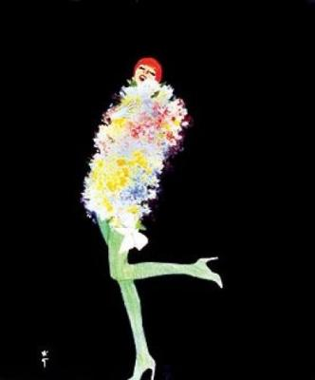
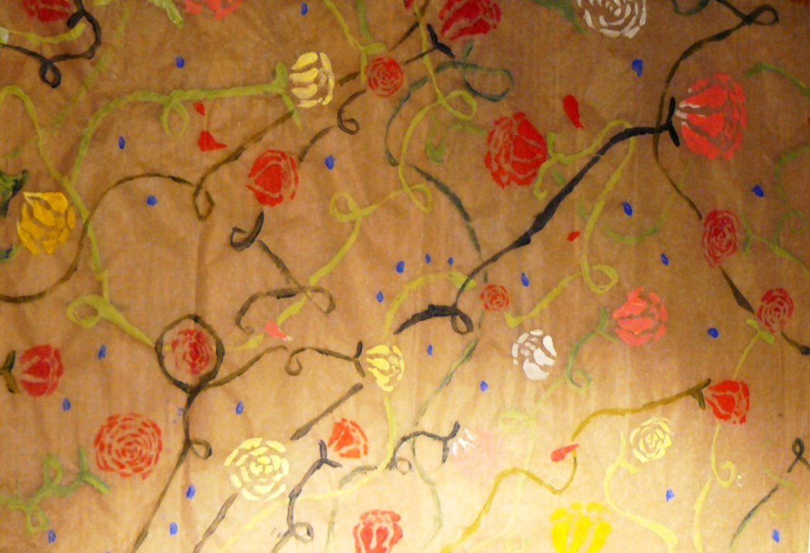
Roses
Acrylic of tissue paper
Illustration 2

Slide 10
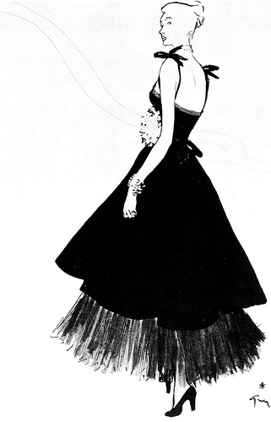
Figure
The stance of the figure is influenced by illustration 3.
I was struck the strength of the woman’s stance in
Gruau’s illustration; she appears quietly
graceful yet confident. As a result I focused
on the stance of the figure and the angles and shapes
I needed to bend the tissue paper into to create this effect.
I had originally hoped to show the figure standing with
her back to the viewer, but because of the medium I
had chosen it would have been difficult to distinguish the
back from the front.
The style of my final piece was influenced by illustrations
4 and 5: the undulating black lines, block colour and
minimal detail create a dramatic pose, a strong expression
and colour that jumps from the page because it contrasts
With the blankness of the white background.
This made me realise the importance of space in
illustration: sometimes what isn’t there can be more
powerful than what is.
This is why I showed just the outline of the figure – using the paper to create an image of the figure as a whole would have given me the chiffon-effect I wanted but without the drama I loved in Gruau’s illustration.
Illustration 3

Slide 11
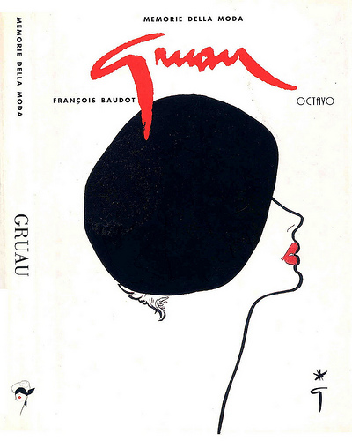
Style
Illustration 4 helped me to finalise the style of
hat and the angle of the face. I wanted to
emulate the style of the 1940’s and ‘50’s, so I
used details from ‘Costume, 1066 – 1990s...’ I
aimed for a similar style to the dress in fig. 1:
a full skirt, a boned bodice and soft fabric in
a delicate floral pattern. The hats in figures
2, 3 and 4 prompted my stylisation of the hat
in the final piece; I curled the paper into a soft
spiral to give the impression to a wide-brimmed
hat.
I liked how the bright red lips in illustration 4 define
the illustration. I incorporated this idea into my final
piece by attaching two small triangles of paper painted
with gouache in cadmium red to the board. This also
helped to strengthen the structure of my illustration.
Illustration 4

Slide 12
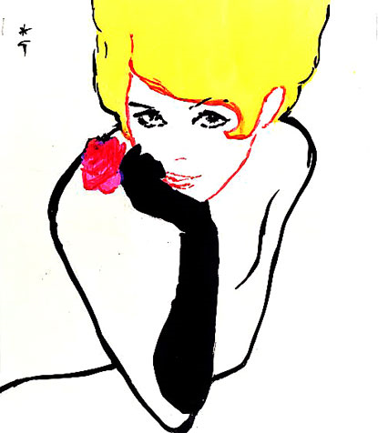
Illustration 5

Slide 13
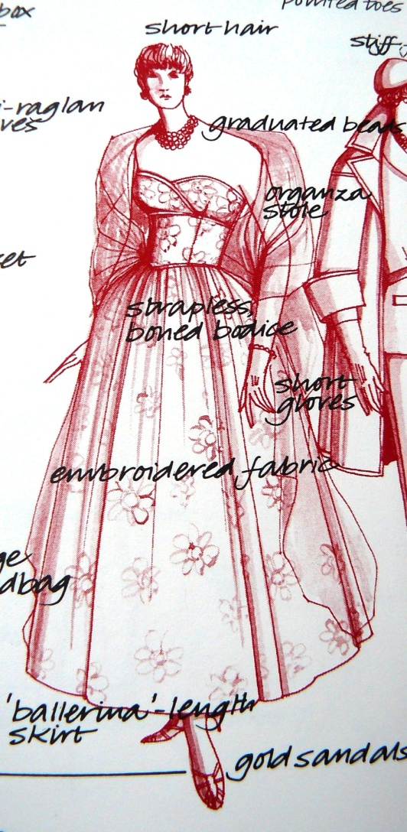
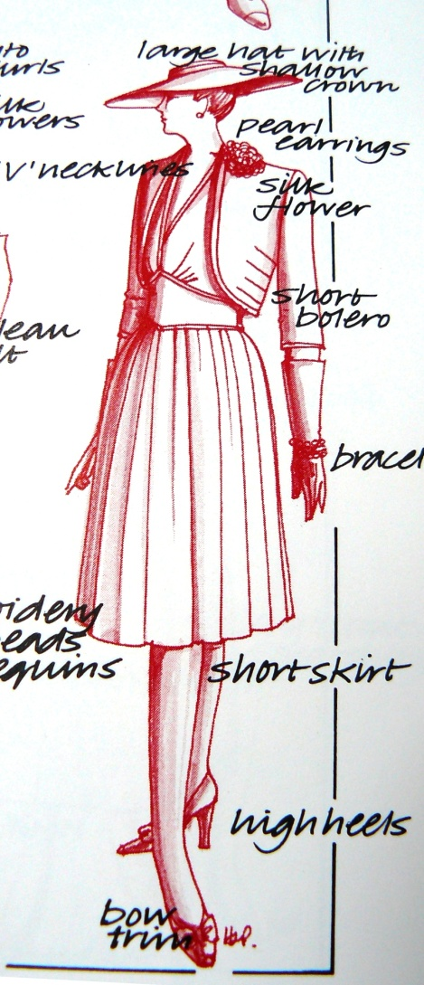
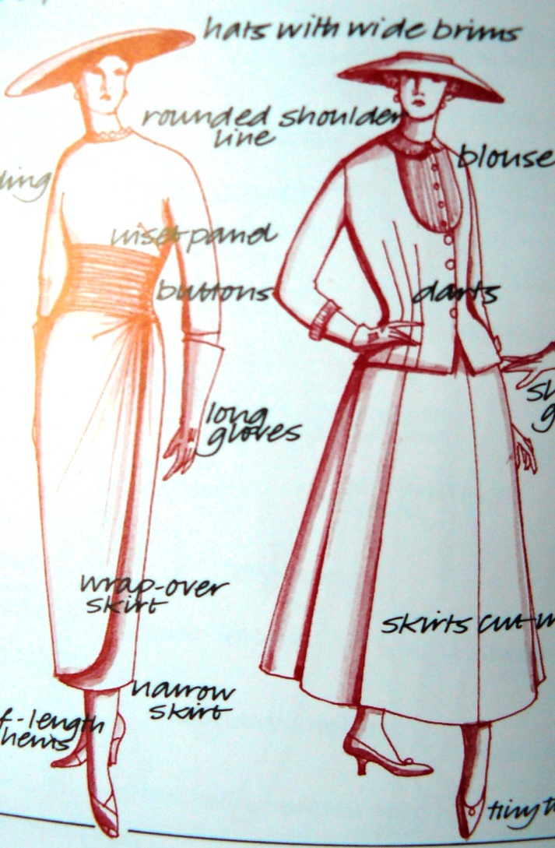
Illustrations from ‘Costume, 1066 – 1990s: A Complete Guide to English Costume Design and History’, J. Peacock (Thames & Hudson, 1994, 2nd edition)
Figure 1
Figure 2
Figures 3 and 4
p. 123, c. 1952 – 56
p. 121, c. 1943 – 47
p. 122, c. 1947 – 52

Slide 14
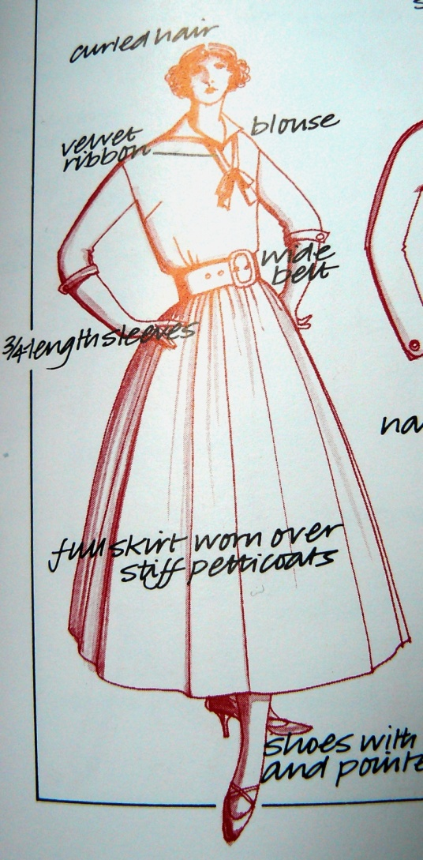
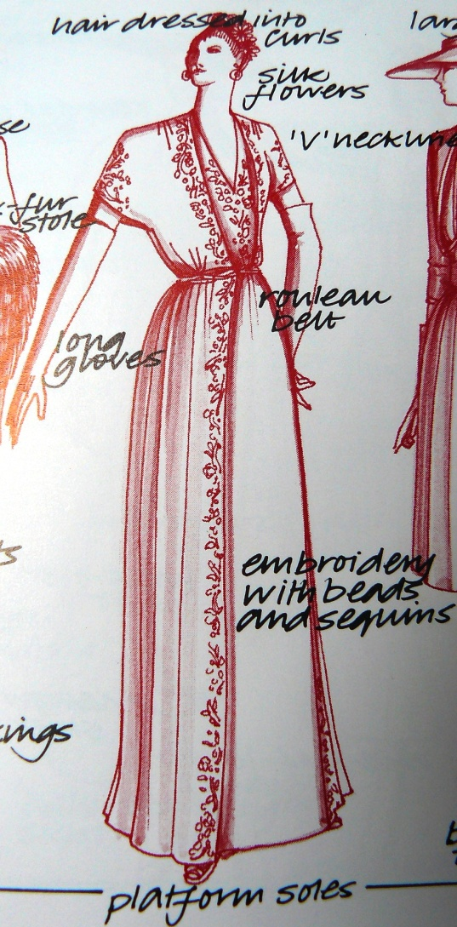
Illustrations from ‘Costume, 1066 – 1990s... continued
Figure 6
p. 121, c. 1943 – 47
Figure 5
p. 123, c. 1952 – 56

Slide 15
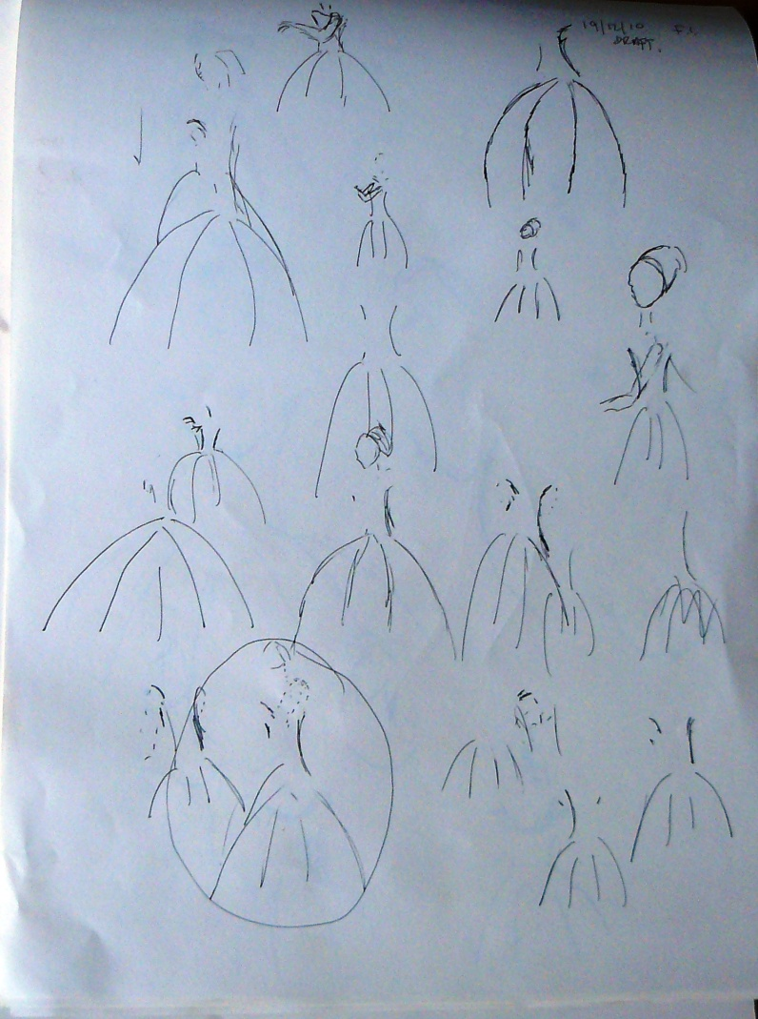
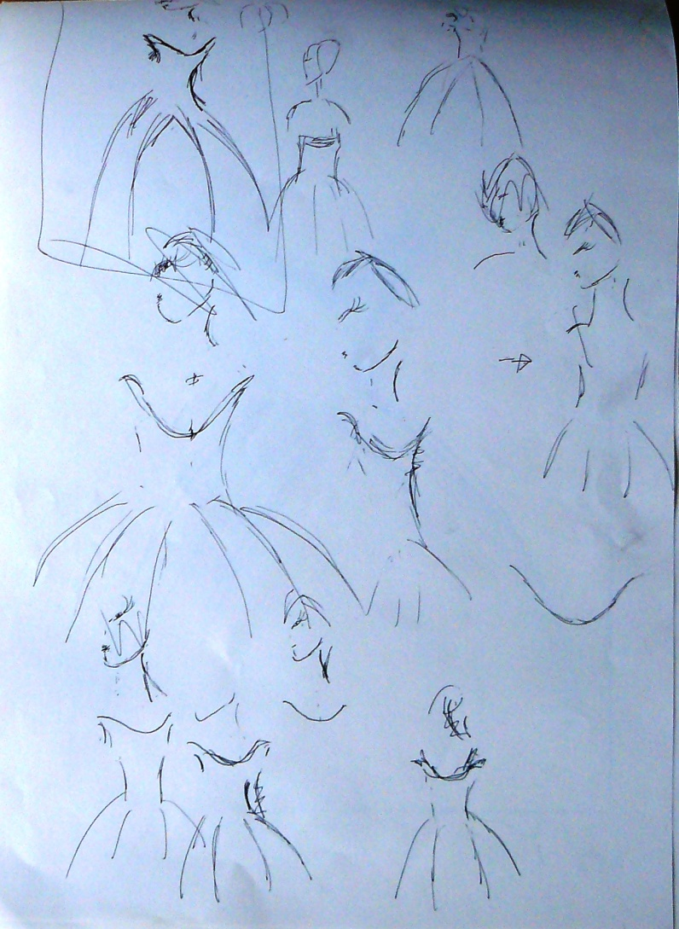
Sketches pages 1 and 2
The following sketches are experimentations with different angles in order to achieve the best template for the final piece. I had initially intended to include four lines in the skirt, hence their inclusion in the sketches. I later omitted these lines to make the final piece more succinct.

Slide 16
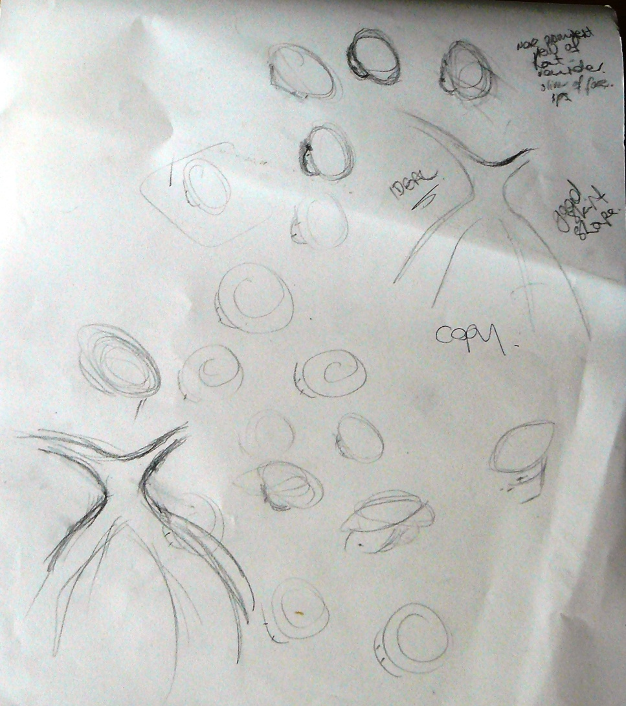
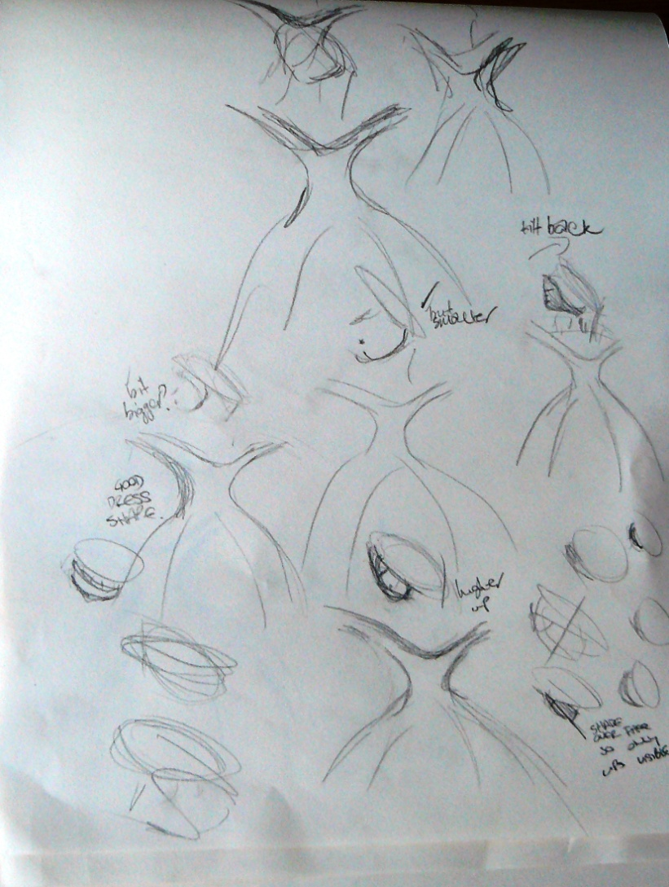
Sketches pages 3 and 4

Slide 17
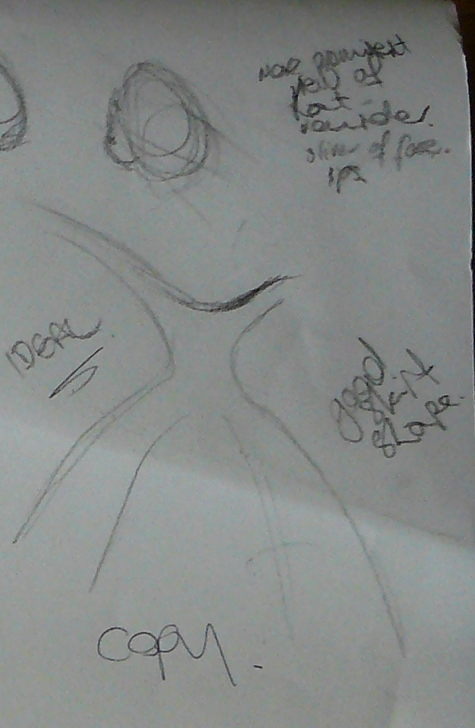
Chosen shape detail from Sketches, page 3

Slide 18
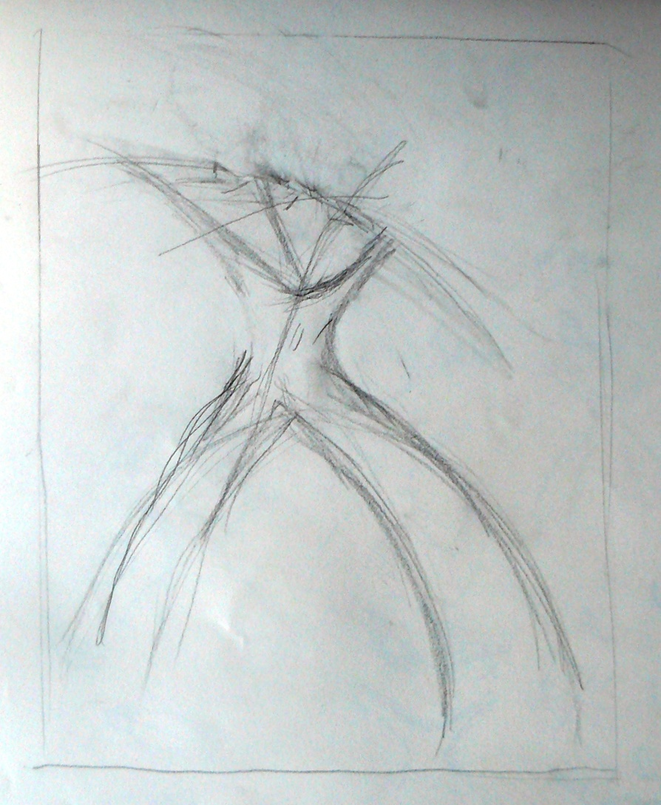
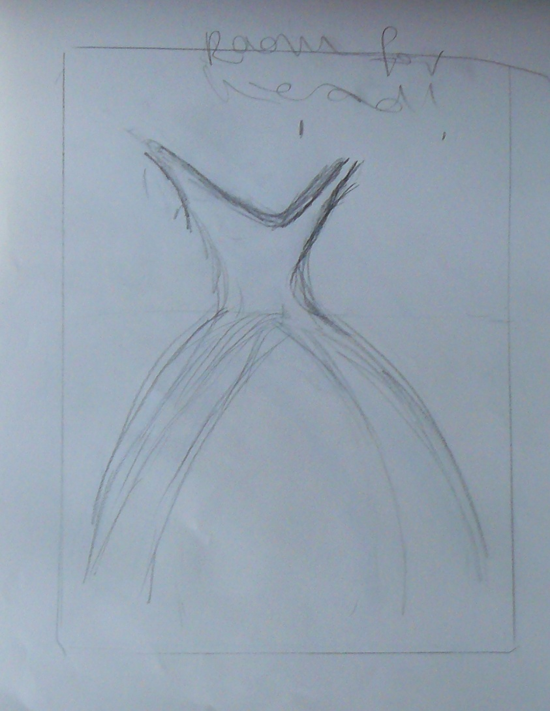
Sketches shape of dress based on above

Slide 19
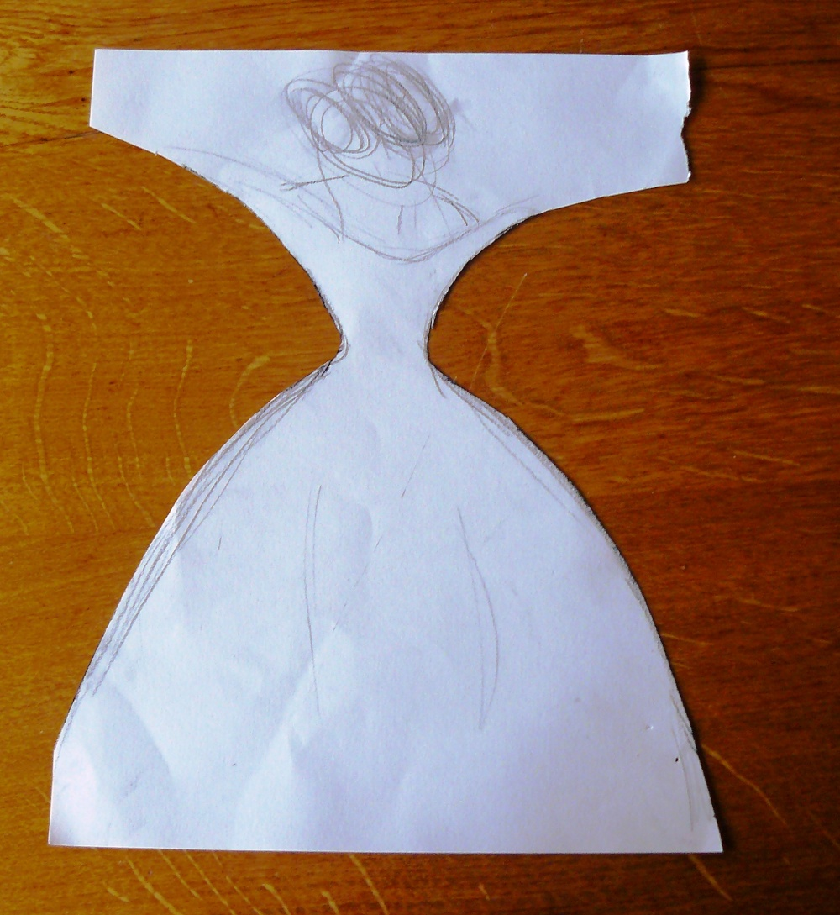
Final sketch used as a template for the final piece

Slide 20
Positive aspects:
The pattern works very well on the paper.
The black background gives the dramatic effect I wanted to achieve.
The work that I have done for this project enables me to create bigger versions of the piece or adapt an aspect of it for other use:
I would happily use the pattern again and would like to incorporate it into a textile design or use it as a print in a fashion design.
I have completed a project that I set myself and feel I have done a good amount of research and work on its development.
Project Evaluation
Potential Improvements:
The figure did not turn out as realistically as I had hoped. I feel this was because I was inhibited by the size of the board - the figure needs to be longer and there needs to be more space between the dress and the hat.
I would like to make the piece again with the dimensions of 2 x 4 metres. This would afford me greater accuracy and realism in the shape of the dress and positioning of the hat.
In this case I think I would use a lightweight cotton and light it from the back to give it luminosity.
I am unsure whether final piece reflects the amount of work done in the project.
Final piece

